Slide 1

Data Minders
ABC Pharmaceutical EDA
7-30-2024

Slide 2
Background
ABC is a pharmaceutical company keen on understanding persistency of a drug based on physician prescriptions for patients. To tackle this, ABC has engaged an analytics company to automate the identification of persistency.
Objective : Creating an automated solution to evaluate and enhance the persistency of a drug for ABC.
The analysis has been divided into four parts:
Data Understanding
Data Exploration
Data Transformation
Recommendation

Slide 3
Data Understanding
Features (including derived features): 70
Total data points: 3424
Size of data: 899 KB
Timeline of data:
Type of data: The dataset contains 69 columns, mainly with binary data labeled "Y" or "N," and data types
include 'object' and 'int64'. The target variable, "Persistency_Flag," is binary.

Slide 4
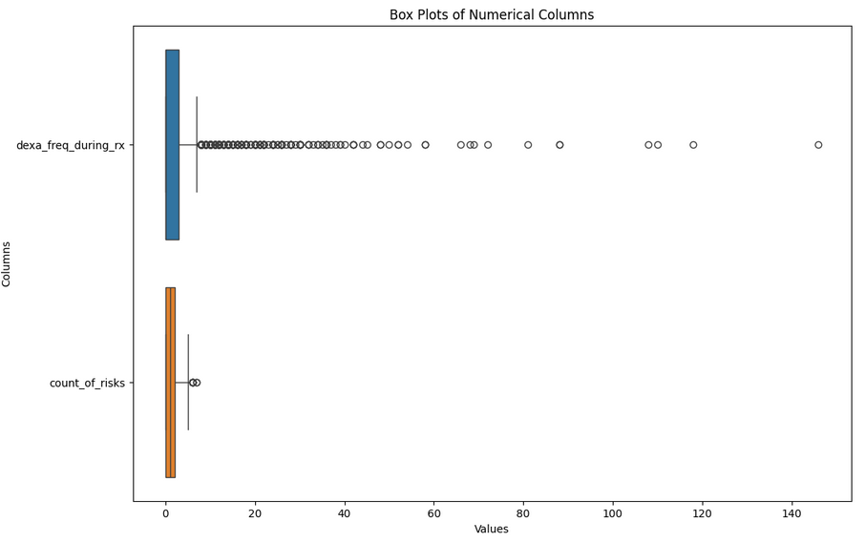
Data Exploration
OUTLIERS: Outliers were found and removed from the dataset, specifically in
'dexa_freq_during_rx' and 'count_of_risks', reducing the dataset size from 3,424 to 2,956 entries.

Slide 5
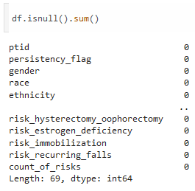
Data Exploration
Missing Values: No missing values ("N/A") were found in the dataset.

Slide 6
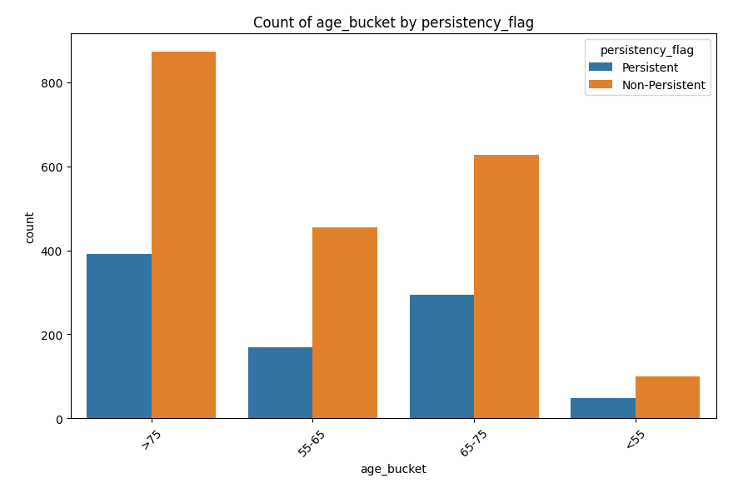
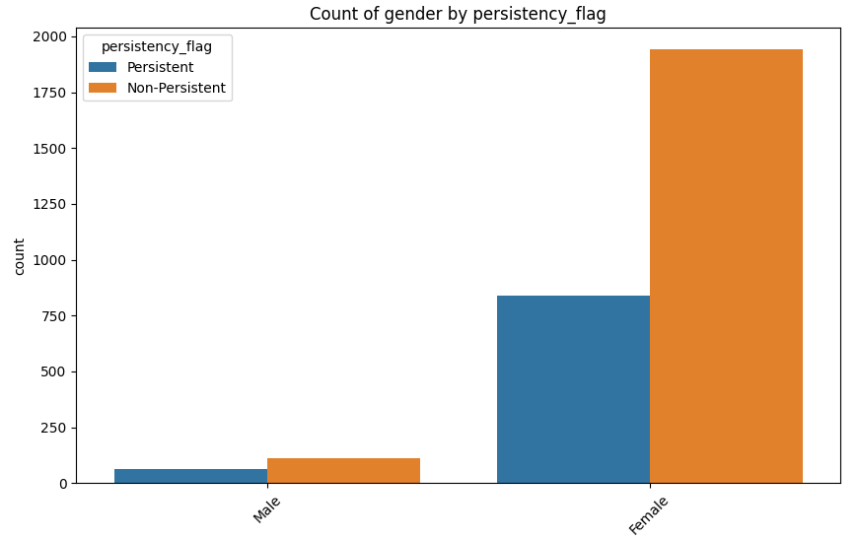
Data Exploration
Gender and age by persistency histograms:

Slide 7
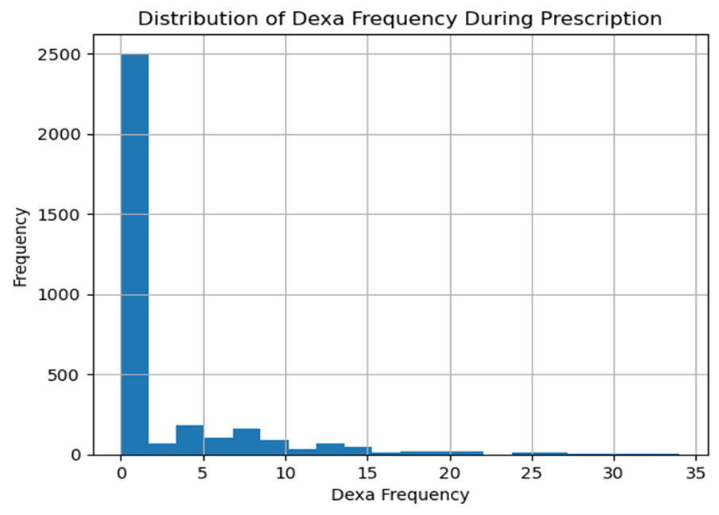
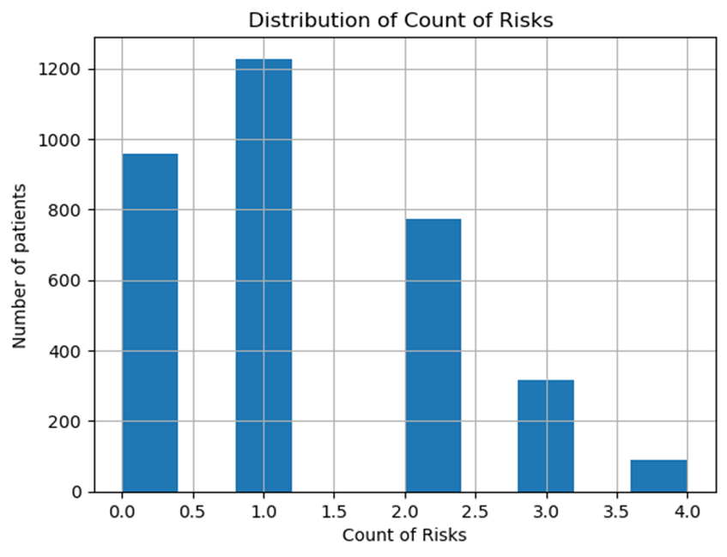
Visualization Results

Slide 8
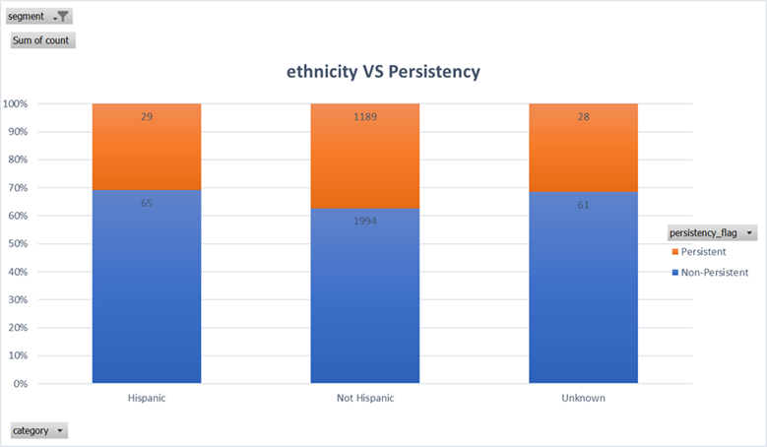
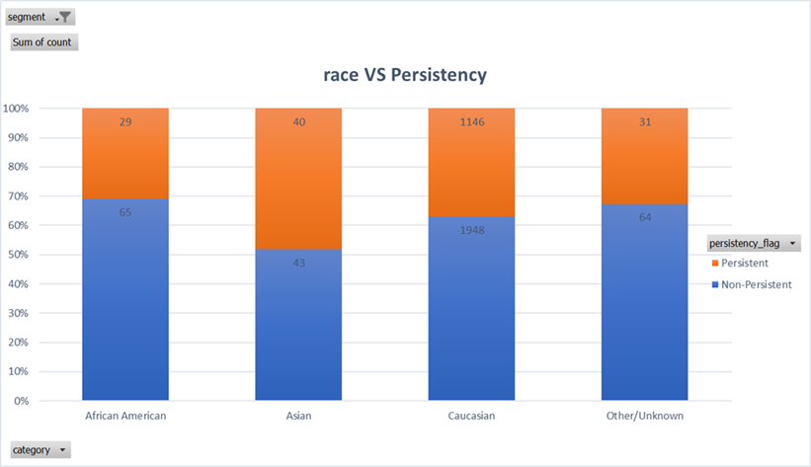
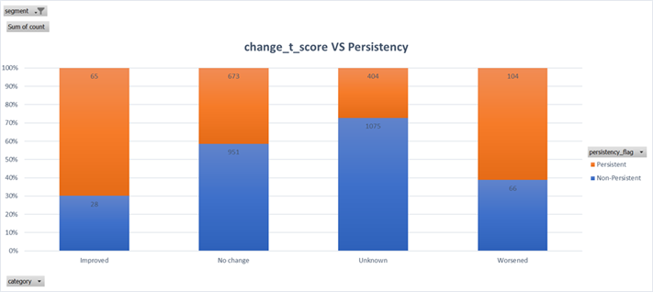
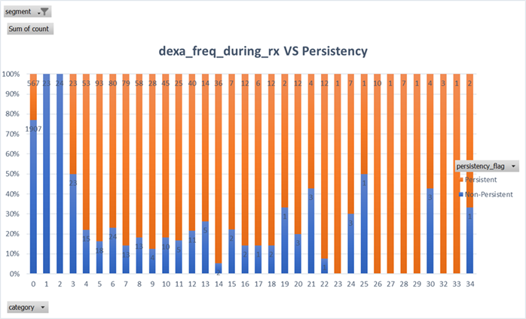
Visualization Results

Slide 9
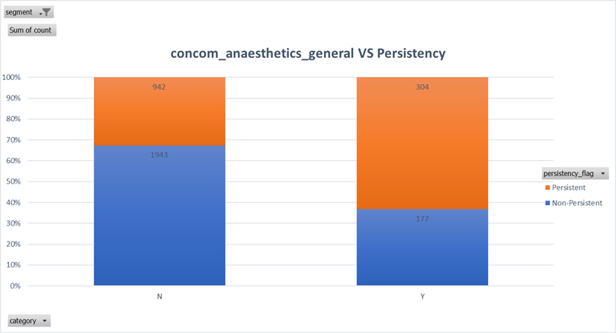
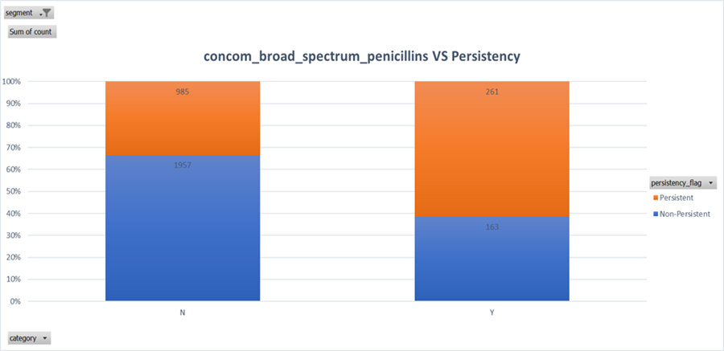
Visualization Results

Slide 10
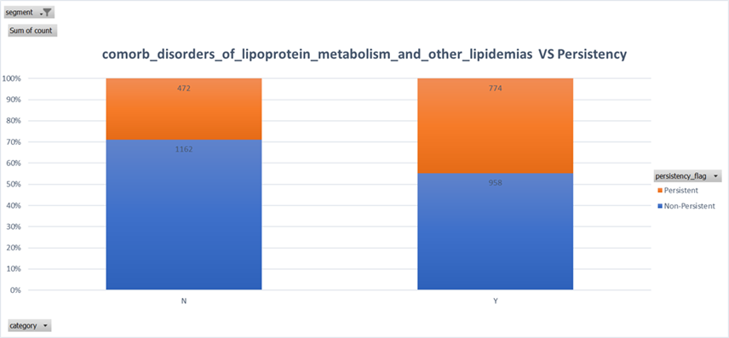

Visualization Results

Slide 11
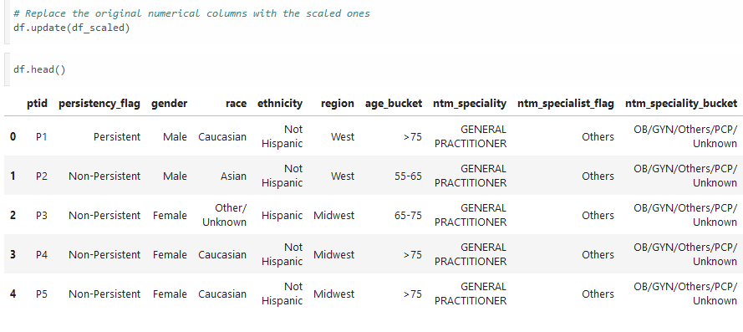
Data Transformation
Scaling: Standard scaling was used to prevent bias and and ensure interpretability.

Slide 12
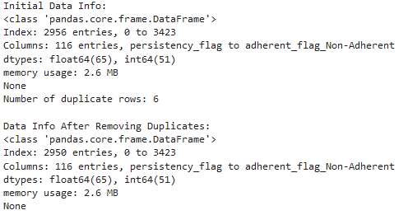
Data Transformation
Duplicates: 6 rows of duplicates were removed total.

Slide 13
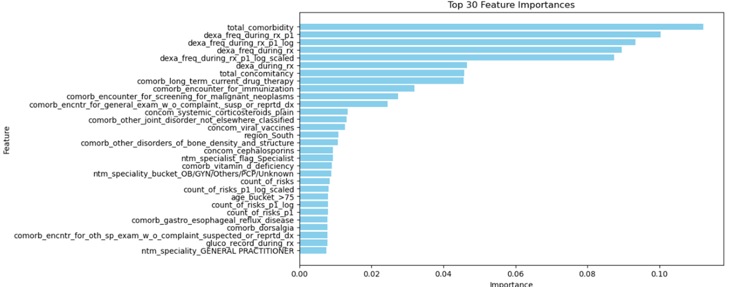
Test Variable Importance by Random Forest Model

Slide 14
Data Transformation
Feature engineering:
•Convert "Y" and "N" to 1 and 0
•Create new Features: total number of concomitancy, total number of comorbidity
•Encoding categorical variables: one-hot encoding
•Scaling and normalization: log transformation
•Feature Selection: drop columns which have no impact on drug_persistency

Slide 15
Recommendations
•The following variables have no impact on drug persistency,
ptid , gender, frag_frac_prior_ntm, gluco_record_prior_ntm,
risk_patient_parent_fractured_their_hip, risk_segment_prior_ntm,
risk_untreated_chronic_hyperthyroidism, risk_estrogen_deficiency,
risk_family_history_of_osteoporosis

Slide 16
Recommendations
Based on the exploratory data analysis (EDA) results and the insights from the Phik matrix, it is planned to develop robust predictive models with special attention to addressing multicollinearity and class imbalance. Multicollinearity, identified using the Phik matrix, is intended to be mitigated through methods such as Principal Component Analysis (PCA) and regularization (Lasso and Ridge), which will help adjust coefficients and enhance model stability. To address class imbalance, techniques such as SMOTE will be applied to increase the representation of the minority class or adjust class weights algorithmically within the model. Algorithms suitable for binary classification, such as logistic regression, decision trees, and ensemble methods like random forests and gradient boosting machines, are planned due to their reduced sensitivity to multicollinearity and effectiveness in handling class imbalance. To fine-tune model parameters and assess their effectiveness, cross-validation and performance metrics such as precision, recall, and AUC-ROC are intended to be used. These measures will ensure that the predictive modeling efforts are based on sound statistical principles and best practices.

Slide 17
Model Selection
When selecting models for ABC Pharmaceutical's project, we needed solutions capable of handling class imbalance and complex feature interactions.
XGBoost was chosen for its ability to manage large datasets and highlight feature importance, critical for understanding drug persistency factors. The version without PCA preserved the interpretability of individual features.
Random Forest was selected for its robustness against overfitting and its effectiveness in modeling non-linear relationships.
Logistic Regression provided a straightforward, interpretable baseline for comparison.
MLP (Multi-Layer Perceptron) was included to capture complex, non-linear patterns in the data.
Stacking was also employed to leverage the strengths of each individual model, combining their predictions to potentially enhance overall accuracy and robustness.
Each model incorporated class balancing techniques to ensure fair representation of all classes in predictions, addressing the dataset's inherent imbalances.

Slide 18
Choice of Evaluation Metric:
ROC AUC was chosen as the primary metric to assess model effectiveness because:
It effectively handles class imbalance by measuring the model's ability to discriminate between the classes without being misled by the majority class.
It is threshold-independent, providing a comprehensive measure of model performance across all classification thresholds.
ROC curves were constructed for each model to visually assess their performance in distinguishing between the classes.

Slide 19
Results:
ROC AUC was chosen as the primary metric to assess model effectiveness because:
It effectively handles class imbalance by measuring the model's ability to discriminate between the classes without being misled by the majority class.
It is threshold-independent, providing a comprehensive measure of model performance across all classification thresholds.
ROC curves were constructed for each model to visually assess their performance in distinguishing between the classes.

Slide 20
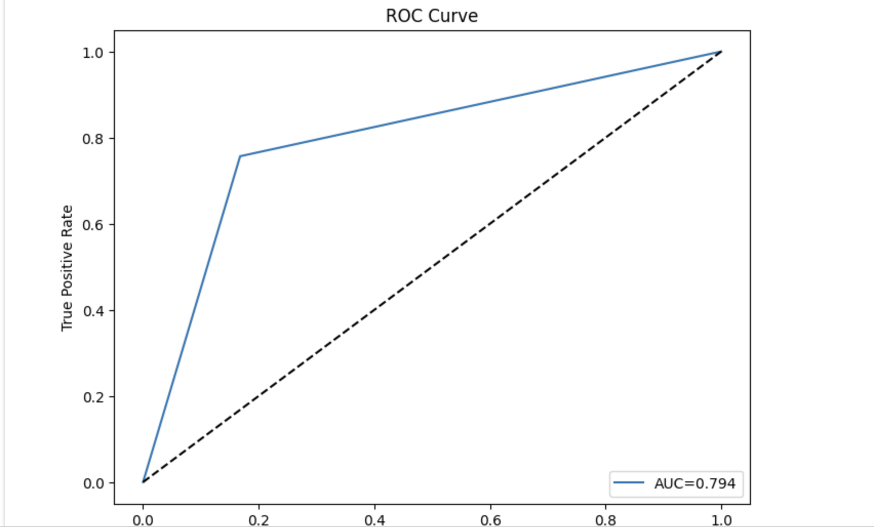
Results:
The XGBoost model without PCA emerged as the superior model, yielding the highest ROC AUC score of 0.794

Slide 21
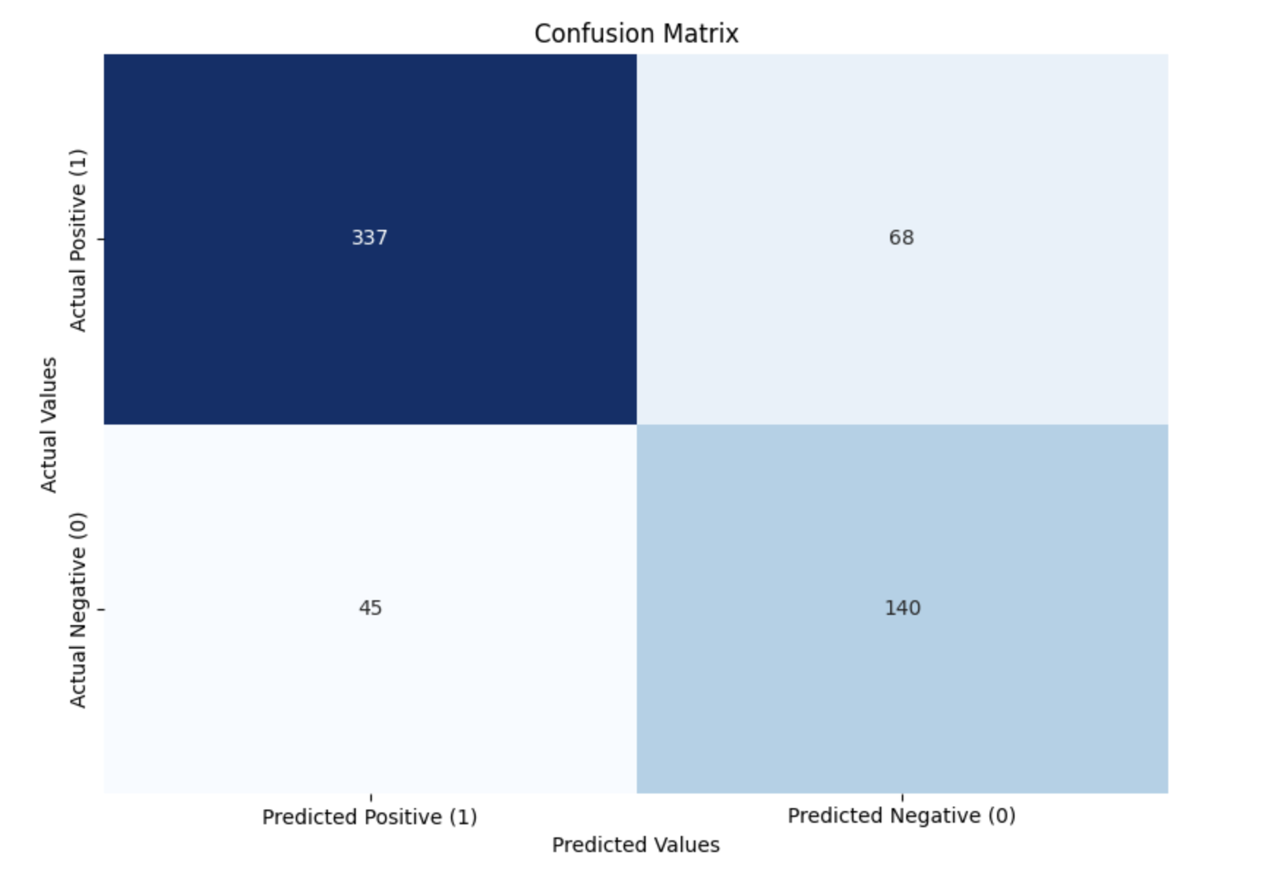
Results:

Slide 22
Conclusion:
The analysis confirmed that XGBoost without PCA is ideally suited for operational deployment due to its robust performance across various metrics. This model not only excels at predicting drug persistency but also offers insights into the features most affecting persistency, which can guide more targeted interventions.

Slide 23
Thank You

